Slide 1
New to F1 and F2
September 2020
Information for Parents

Slide 2
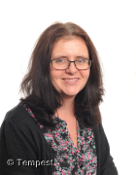
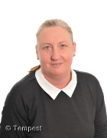
Who’s who in class – F1
Ms Knight
Class Teacher
Mrs Reid
Class Teacher

Slide 3
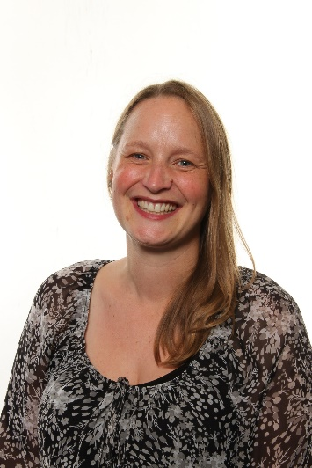
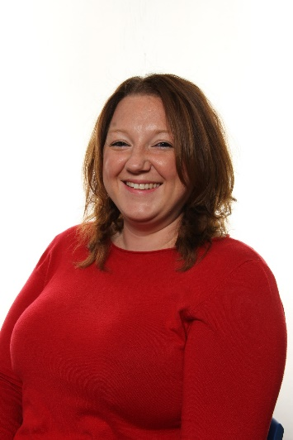
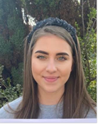
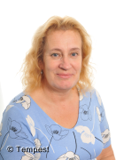
Who’s who in class – F2
Mrs Eccleson
Mrs Keown
Cygnets
Class Teachers
Miss Allen
Goslings
Class Teacher
Mrs Owen Miss Picton

Slide 4
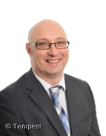
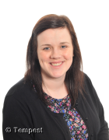
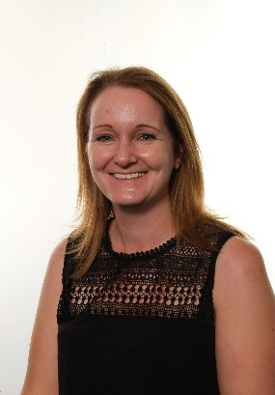
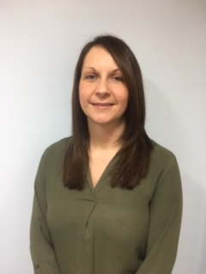
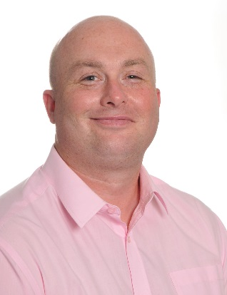
Who’s who around school
Mr Mellin
Headteacher
Mrs Dunne
Deputy Head
Mrs Theobald
Assistant Head
Mrs Eccleson
FS/Y1 Leader
Mrs Smyth
SENDCo
Mr Stuart
Chair of Governors

Slide 5
Continuing the Learning Journey
Foundation Stage
From birth to 5
Foundation 1-children have their 4th birthday in this year. (Nursery)
Foundation 2- children have their 5th birthday in this year. (Reception)
Follow-Early Years Foundation Stage
Key Stage 1 - Infants
Year 1- children turn 6 in this year.
Year 2- children turn 7 in this year.
Follow-National Curriculum
Key Stage 2 - Juniors
Years 3, 4, 5, 6
Follow-National Curriculum

Slide 6
Characteristics of Effective Learning
Playing and exploring (engagement)
Finding out and exploring
Playing with what they know
Being willing to ‘have a go’
Active Learning (motivation)
Being involved and concentrating
Keeping trying
Enjoying achieving what they set out to do
Creating and thinking critically (thinking)
Having their own ideas
Making links

Slide 7
Areas of Learning
PRIME areas are fundamental, work together and move through to support development in all other areas.
Personal, Social and Emotional Development
Communication and Language
Physical Development
SPECIFIC areas include essential skills and knowledge for children to participate successfully in society.
Literacy
Mathematics
Understanding the World
Expressive Arts and Design

Slide 8
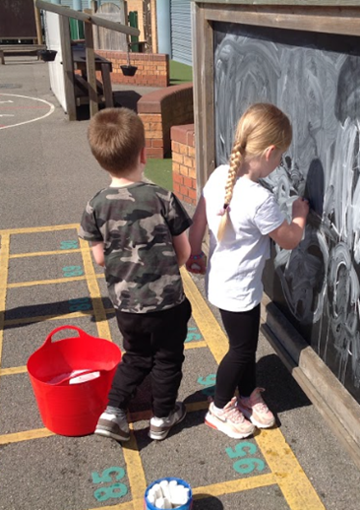
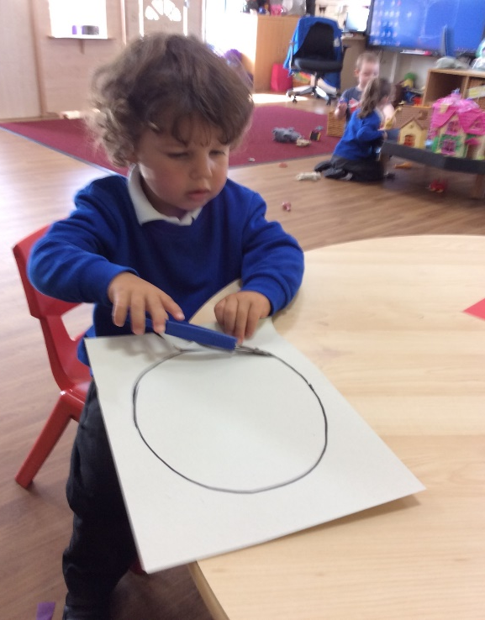
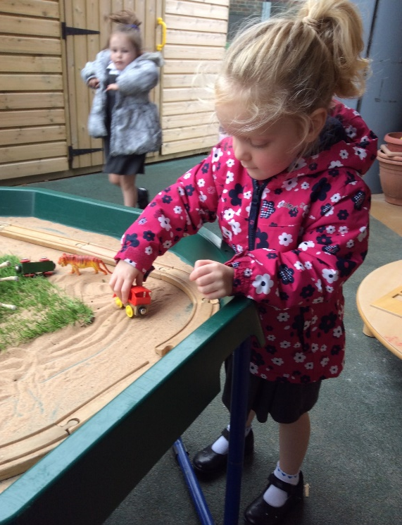
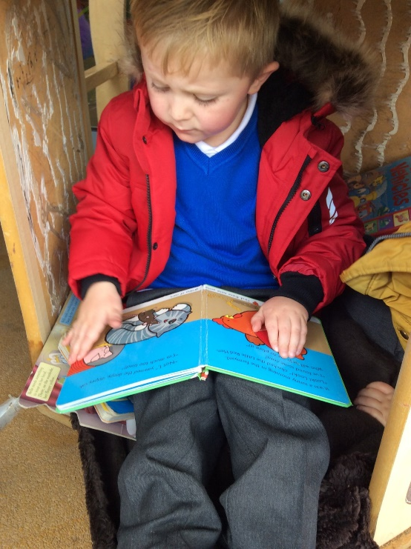
F1 Daily Routine
Self registration
Welcome activities
Adult and independent activities
Challenges
Continuous provision
Key Person Time
Ready for home

Slide 9
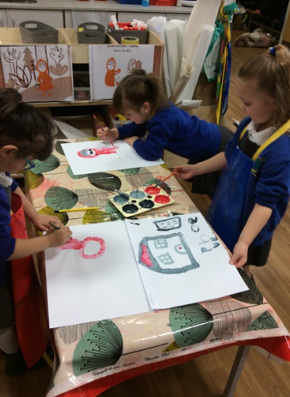
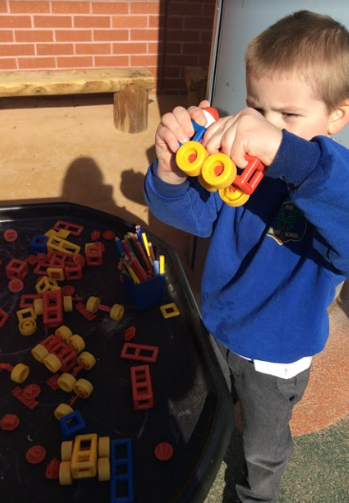
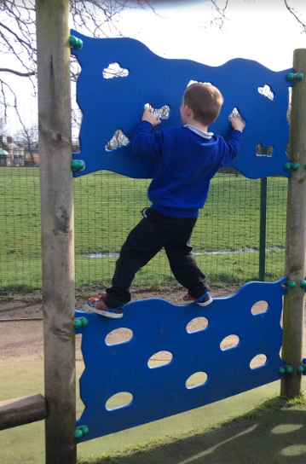
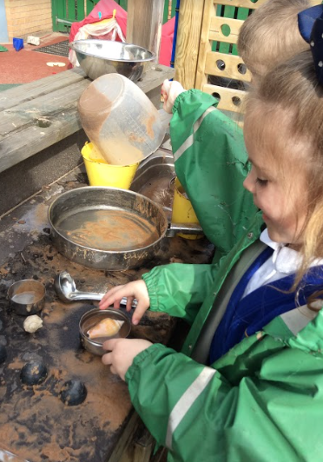
F2 Daily Routine
Welcome activities
Register
Literacy
Phonics
Lunch
Maths
Challenges
Continuous provision
Key Person Time
Ready for home

Slide 10
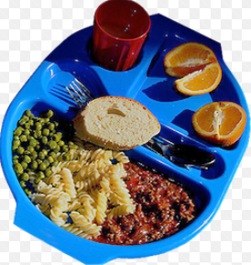
F2 Lunch Time
Our team of experienced Welfare Assistants will look after your child during the lunch break.
All FS and KS1 children are entitled to a free school meal.
The children can choose from a hot meal or access the deli bar.
Have a look at our menus!

Slide 11
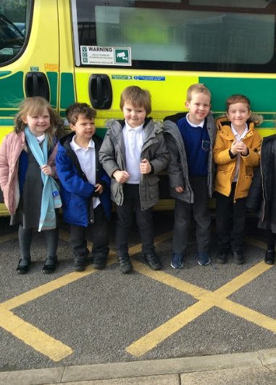
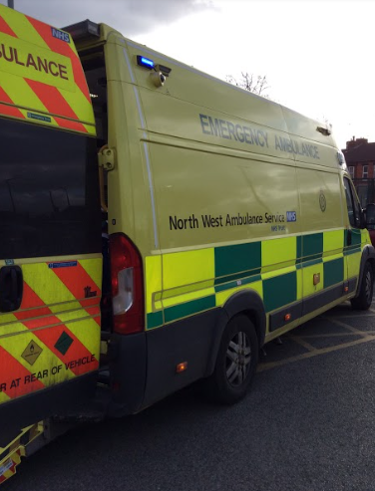
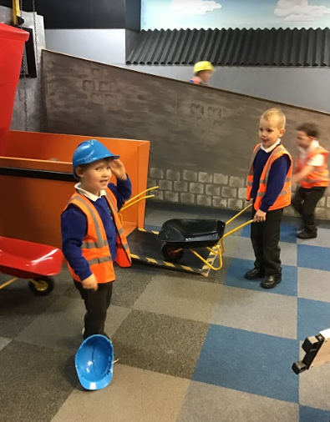
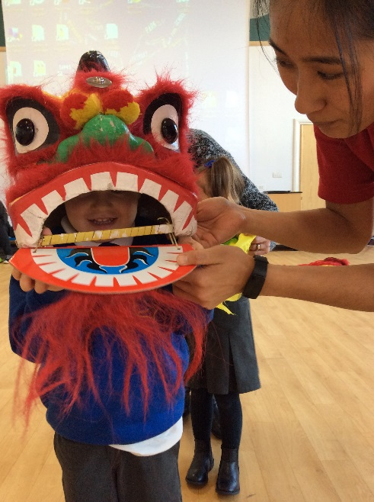
School Trips and Visitors
A fantastic way of gaining experiences and improving confidence and social awareness.
High child adult ratio
Detailed risk assessments

Slide 12
Using the web to keep in touch!
School website is updated regularly including copies of all newsletters and letters sent home
www.parkprimaryschool.com
@ParkWallasey Park Primary School
Our FB page and Twitter feed are used to give reminders and updates.
Class Twitter pages give information about what exciting activities your childs’ class has been taking part in.

Slide 13
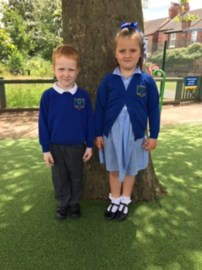
Uniform
Boys
Long grey trousers
White polo t-shirt
Royal blue jumper
Black shoes (no trainers please)
Grey shorts (summer)
Girls
Grey skirt or pinafore
White polo t-shirt
Royal blue jumper or cardigan
Black shoes (no trainers/heels)
Blue gingham dress (summer)

Slide 14
School Uniform Providers
Wallasey Schoolwear
Based at Misty Blues, Manor Road, Wallasey, CH44 1BY
Argyle Sports and Work Wear
66 King Street, Wallasey, Ch44 8AU

Slide 15
PE Kit
White t-shirt
Black shorts
Black pumps
F1 have PE on Fridays and can come to school in sportswear.

Slide 16
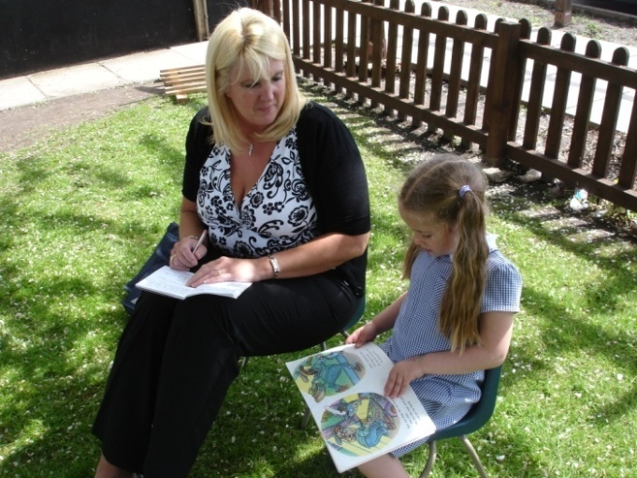
Home-School partnership
Children learn a great deal from their parents and teachers. Home and school are the two most powerful influences on your child and they should be seen to be always working together.
Ways you could join in:
Support our PTA
Attend meetings
Read, read, read!
Be a volunteer reader in school and understand how we teach reading
Trips (when we need extra adults!)

Slide 17
Parent Meetings
We will regularly give you the opportunity to come and look through your child’s learning journey book and celebrate their successes with them
Parents’ Evenings
Workshops with your child will take place throughout the year
Reports in July.

Slide 18
Bits and Bobs!
Please ensure all uniform is labelled with child’s name.
Children need to have a coat in school.
Children sometimes have “accidents”, especially in F1. If these are regular, can you provide a set of spare clothes.
We expect children in F2 to be toilet trained. If there is a medical issue please make an appointment to see the SENDCo.
We are also having a big push on children using a knife and fork independently – if they can’t, please have a practice over the summer.
If someone different is picking your child up – please let us know. We need to ensure that everybody is safe.
We do have breakfast club and after school provision (Park Rangers) If you require out of hours provision please pick up an application form from the school office.

Slide 19
Thank you
We are really looking forward to getting to know you and your children!
If you need any extra information, please phone the school office on: 638 6008

